Slide 1

Crystal Ball Event Prediction (MapReduce) & Log analysis (spark)
By: Jivan Nepali, 985095 Big Data (CS522) Project

Slide 2
Presentation overview
Pair Approach
Pseudo-code for Pair Approach
Java Implementation for Pair Approach
Pair Approach Result
Stripe Approach
Pseudo-code for Stripe Approach
Java Implementation for Stripe Approach
Stripe Approach Result
Hybrid Approach
Pseudo-code for Hybrid Approach
Java Implementation for Hybrid Approach
Hybrid Approach Result
Comparison of three Approaches
Spark
LogAnalysis – Problem Description
LogAnalysis – Expected Outcomes
LogAnalysis – Scala Implementation
LogAnalysis – Results

Slide 3


Pair Approach Implementation

Slide 4
Pseudo code – MAPPER
Class MAPPER
method INITIALIZE
H = new Associative Array
method MAP (docid a, doc d)
for all term w in doc d do
for all term u in Neighbors(w) do
H { Pair (w, u) } = H {Pair (w, u) } + count 1 // Tally counts
H { Pair(w, *) } = H { Pair (w, *) } + count 1 // Tally counts for *
method CLOSE
for all Pair (w, u) in H do
EMIT ( Pair (w, u), count H { Pair (w, u) } )

Slide 5
PSUDEO CODE - REDUCER
Class REDUCER
method INITIALIZE
TOTALFREQ = 0
method REDUCE (Pair p, counts [c1, c2, c3, … ])
sum = 0
for all count c in counts [c1, c2, c3, … ]) do
sum = sum + c
if ( p.getNeighbor() == “*”)) then //Neighbor is second element of the pair
TOTALFREQ = sum
else
EMIT ( Pair p, sum / TOTALFREQ)

Slide 6
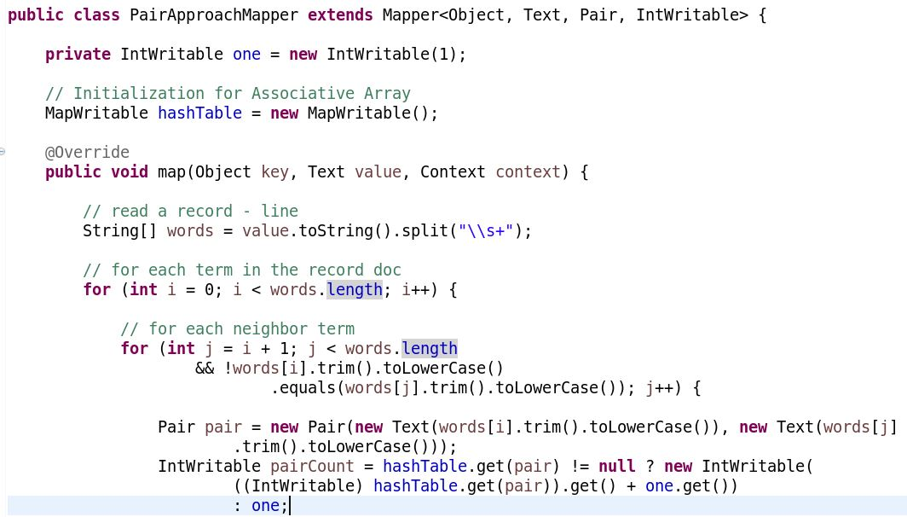
Implementation - mapper

Slide 7
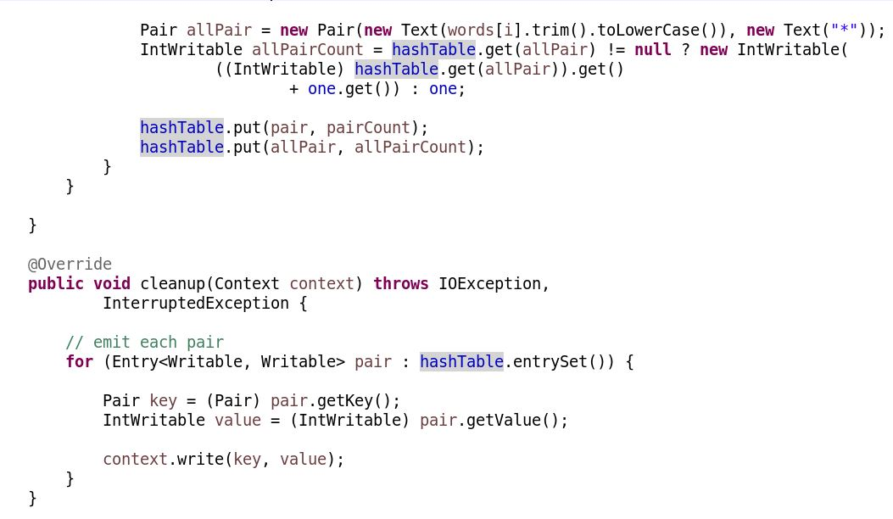
Implementation – mapper Contd…

Slide 8
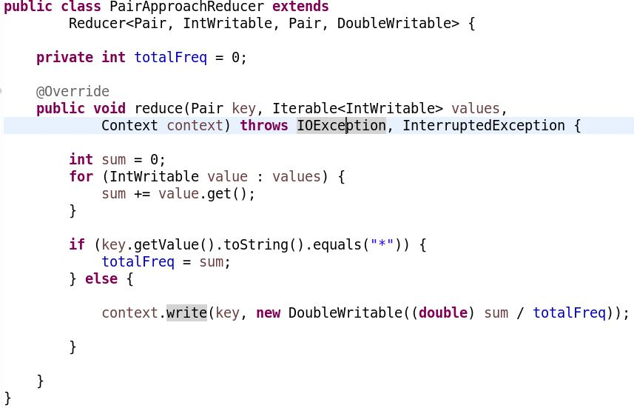
Implementation - reducer

Slide 9
Pair approach – Map input records
18 34 56 29 12 34 56 92 29 34 12
92 29 18 12 34 79 29 56 12 34 18

Slide 10
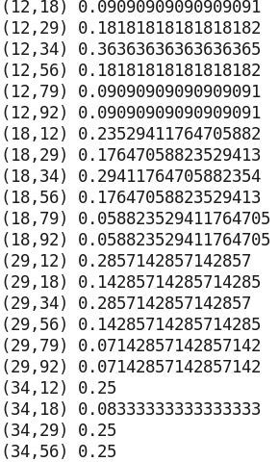
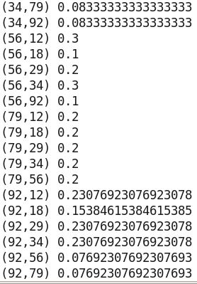
Pair approach - result

Slide 11
Stripe Approach Implementation

Slide 12
Pseudo code – MAPPER
Class MAPPER
method INITIALIZE
H = new Associative Array
method MAP (docid a, doc d)
for all term w in doc d do
S = H { w } // Initialize a new Associative Array if H {w} is NULL
for all term u in Neighbors(w) do
S { u } = S { u } + count 1 // Tally counts
H { w } = S
method CLOSE
for all term t in H do
EMIT ( term t, stripe H { t } )

Slide 13
PSUDEO CODE - REDUCER
Class REDUCER
method INITIALIZE
TOTALFREQ = 0
Hf = new Associative Array
method REDUCE (term t, stripes [H1, H2, H3, … ])
for all stripe H in stripes [H1, H2, H3, … ]) do
for all term w in stripe H do
Hf { w } = Hf { w } + H { w } // Hf = Hf + H ; Element-wise addition
TOTALFREQ = TOTALFREQ + count H { w }
for all term w in stripe Hf do
Hf { w } = Hf { w } / TOTALFREQ
EMIT ( term t, stripe Hf )

Slide 14
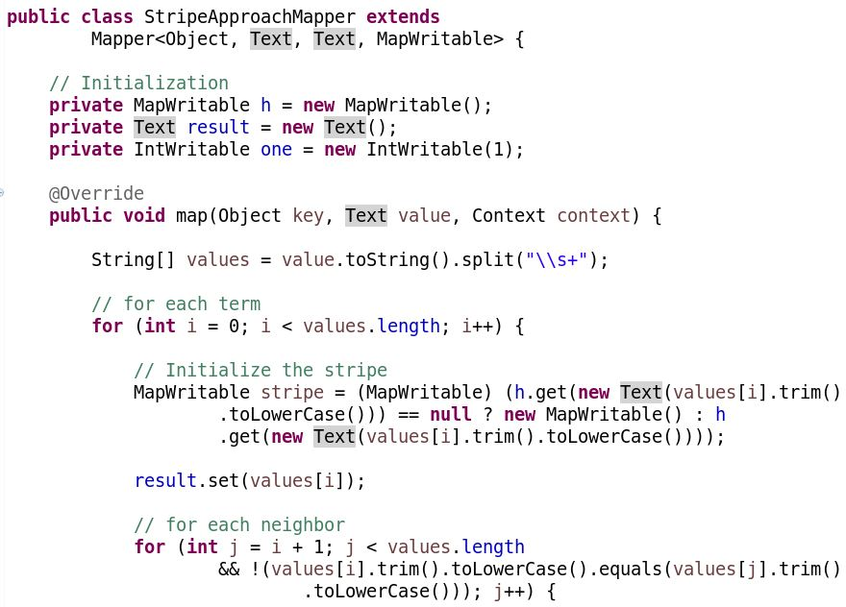
Implementation - mapper

Slide 15
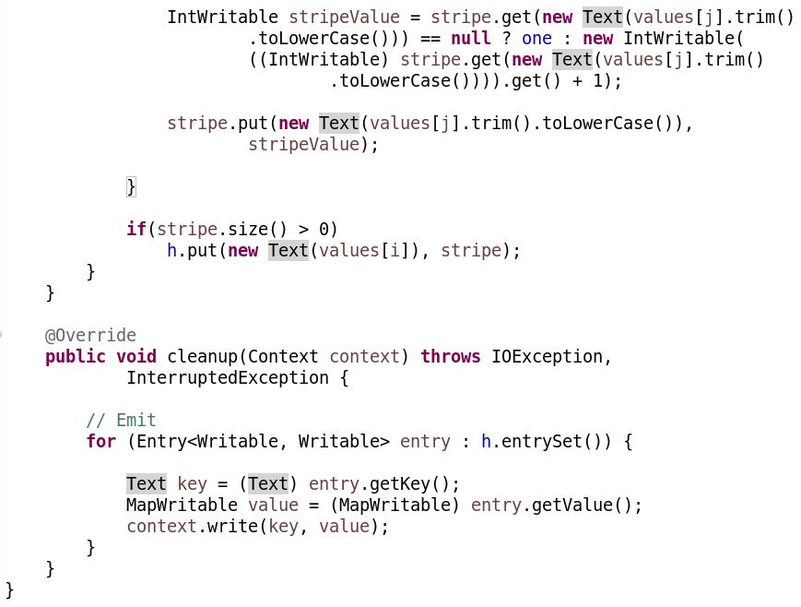
Implementation – mapper Contd…

Slide 16
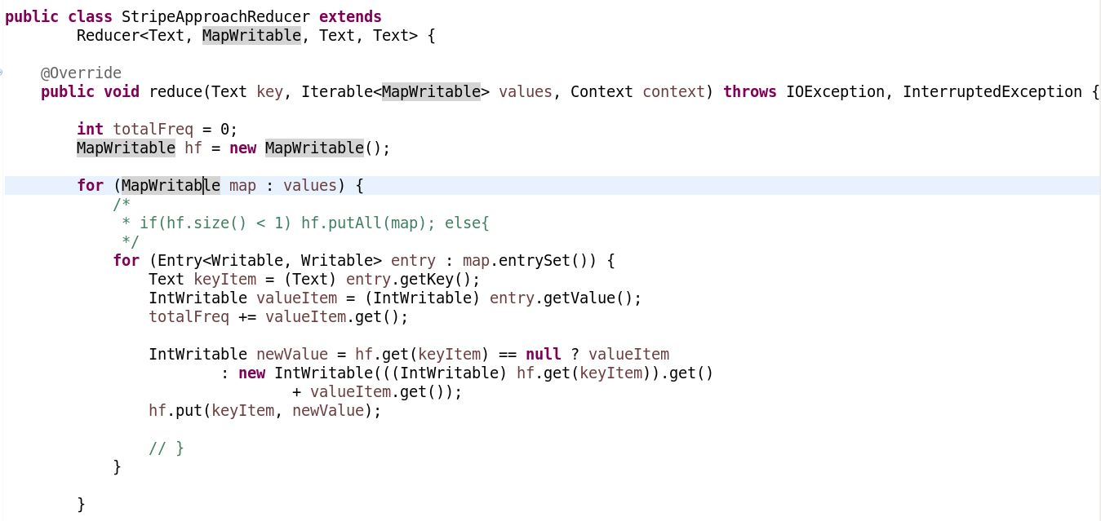
Implementation - reducer

Slide 17
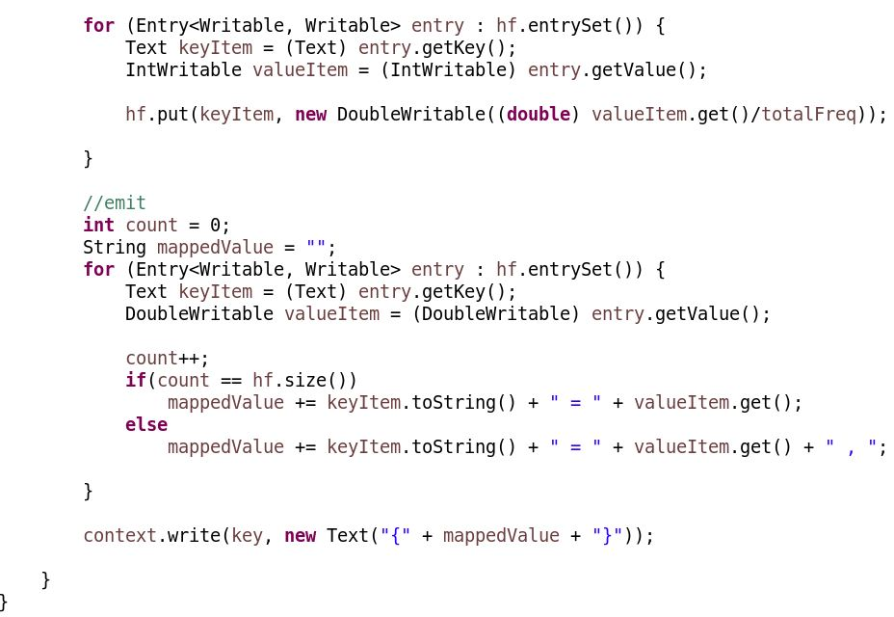
Implementation – reducer contd…

Slide 18
Stripe approach – Map input records
18 34 56 29 12 34 56 92 29 34 12
92 29 18 12 34 79 29 56 12 34 18

Slide 19
Stripe approach - result

Slide 20
Hybrid Approach Implementation

Slide 21
Pseudo code – MAPPER
Class MAPPER
method INITIALIZE
H = new Associative Array
method MAP (docid a, doc d)
for all term w in doc d do
for all term u in Neighbors(w) do
H { Pair (w, u) } = H {Pair (w, u) } + count 1 // Tally counts
method CLOSE
for all Pair (w, u) in H do
EMIT ( Pair (w, u), count H { Pair (w, u) } )

Slide 22
PSUDEO CODE - REDUCER
Class REDUCER
method INITIALIZE
TOTALFREQ = 0
Hf = new Associative Array
PREVKEY = “”
method REDUCE (Pair p, counts [C1, C2, C3, … ])
sum = 0
for all count c in counts [ C1, C2, C3, … ] do
sum = sum + c
if ( PREVKEY <> p.getKey( )) then
EMIT ( PREVKEY, Hf / TOTALFREQ ) // Element-wise divide
Hf = new Associative Array
TOTALFREQ = 0

Slide 23
PSUDEO CODE – REDUCER contd…
TOTALFREQ = TOTALFREQ + sum
Hf { p.getNeighbor( ) } = Hf { p.getNeighbor( ) } + sum
PREVKEY = p.getKey( )
method CLOSE // for the remaining last key
EMIT ( PREVKEY, Hf / TOTALFREQ ) // Element-wise divide

Slide 24
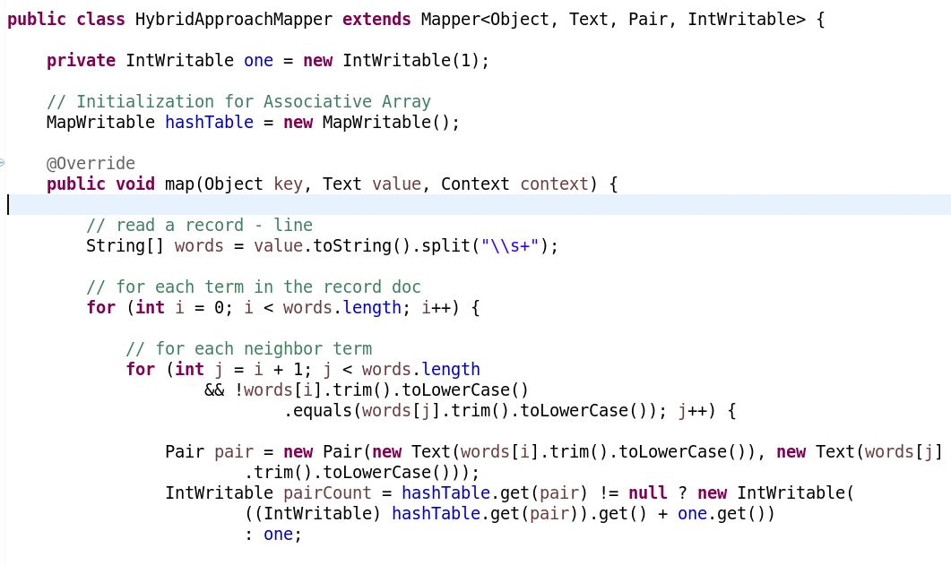
Implementation - mapper

Slide 25
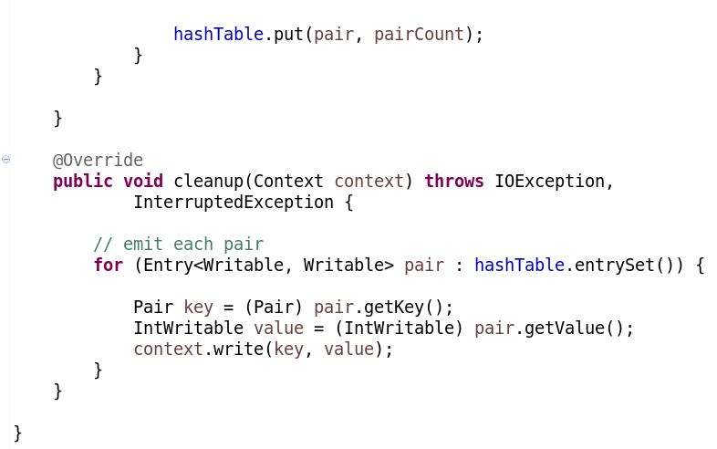
Implementation – mapper conted…

Slide 26
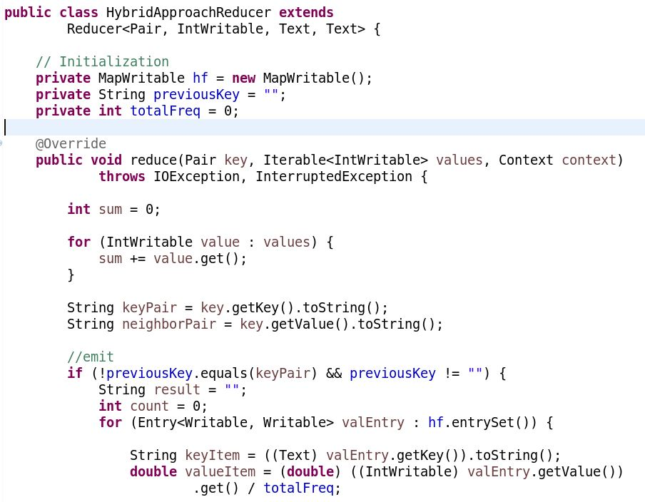
Implementation - reducer

Slide 27
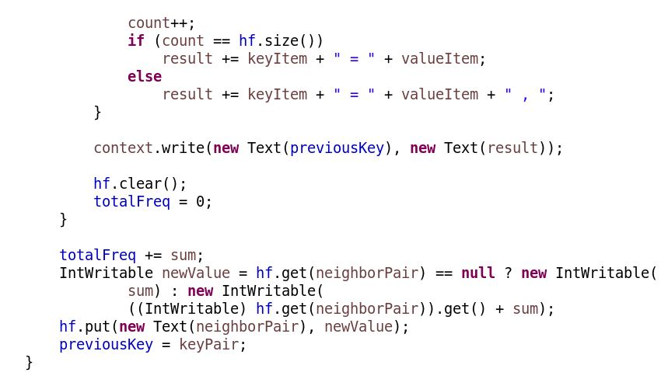
Implementation – reducer contd …

Slide 28
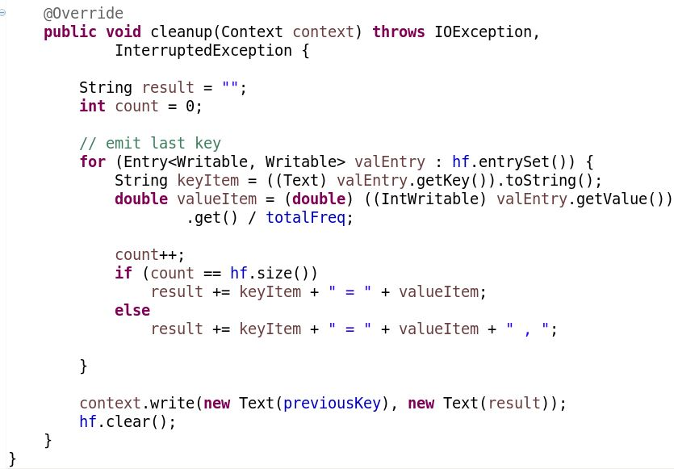
Implementation – reducer contd …

Slide 29
Hybrid approach – Map input records
18 34 56 29 12 34 56 92 29 34 12
92 29 18 12 34 79 29 56 12 34 18

Slide 30
Hybrid approach - result

Slide 31
Map-reduce Job Performance comparison with counters
Description | Pair Approach | Stripe Approach | Hybrid Approach
Map Input Records | 2 | 2 | 2
Map Output Records | 47 | 7 | 40
Map Output Bytes | 463 | 416 | 400
Map Output Materialized Bytes | 563 | 436 | 486
Input-split Bytes | 147 | 149 | 149
Combine Input Records | 0 | 0 | 0
Combine Output Records | 0 | 0 | 0
Reduce Input Groups | 47 | 7 | 40
Reduce Shuffle Bytes | 563 | 436 | 486
Reduce Input Records | 47 | 7 | 40
Reduce Output Records | 40 | 7 | 7
Shuffled Maps | 1 | 1 | 1
GC Time Elapsed (ms) | 140 | 175 | 129
CPU Time Spent (ms) | 1540 | 1530 | 1700
Physical Memory (bytes) Snapshot | 357101568 | 354013184 | 352686080
Virtual Memory (bytes) Snapshot | 3022008320 | 3019862016 | 3020025856
Total Committed Heap Usage (bytes) | 226365440 | 226365440 | 226365440

Slide 32



Log analysis with spark

Slide 33
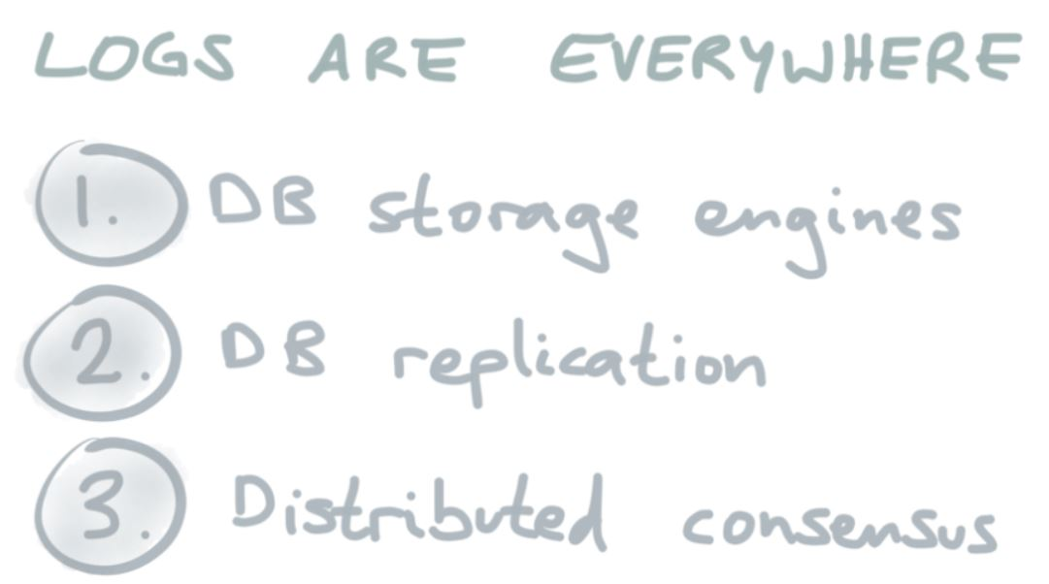
Log Analysis
Log data is a definitive record of what's happening in every business, organization or agency and it’s often an untapped resource when it comes to troubleshooting and supporting broader business objectives.
1.5 Millions Log Lines Per Second !

Slide 34
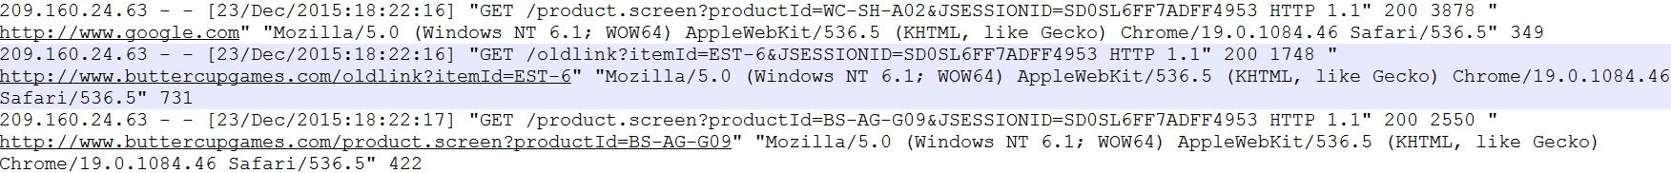
Problem description
Web-access log data from Splunk
Three log files ( ~ 12 MB)
Features
Extract top selling products
Extract top selling product categories
Extract top client IPs visiting the e-commerce site
Sample Data

Slide 35
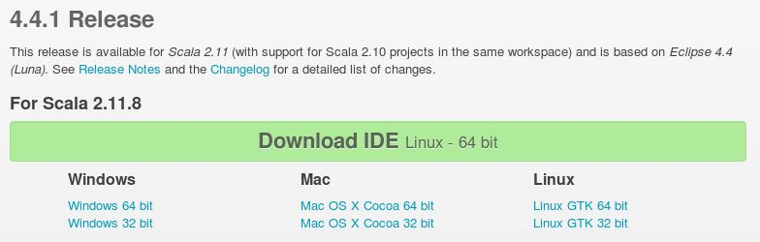
Spark, scala configuration in eclipse
Download Scala IDE from http://scala-ide.org/download/sdk.html for Linux 64 bit

Slide 36
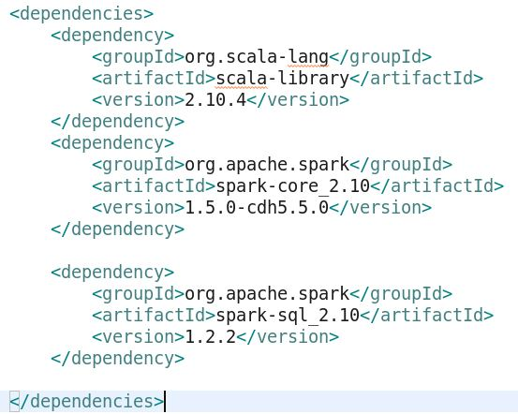
Spark, scala configuration in eclipse
Open the Scala IDE
Create a new Maven Project
Configure the pom.xml file
maven clean, maven install
Set the Scala Installation to Scala 2.10.4 from Project -> Scala -> Set Installation

Slide 37
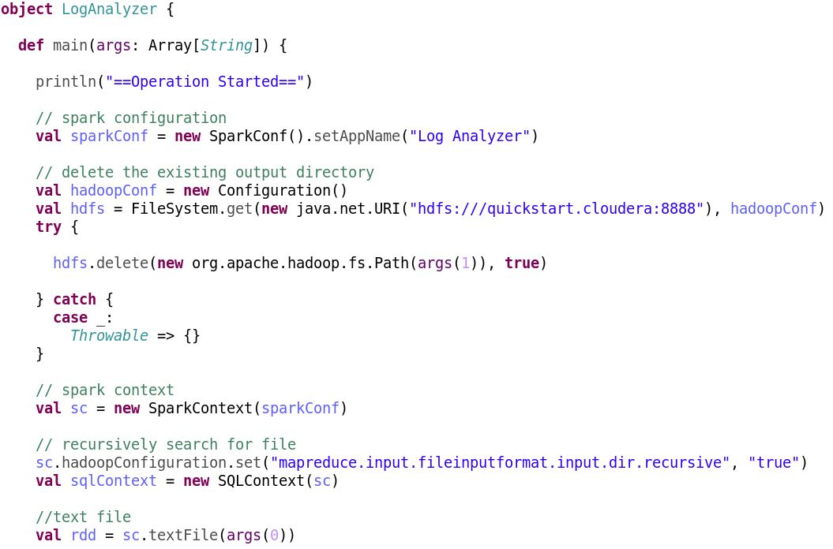
Log analysis - Scala implementation
Add new Scala Object to the src directory of the project

Slide 38
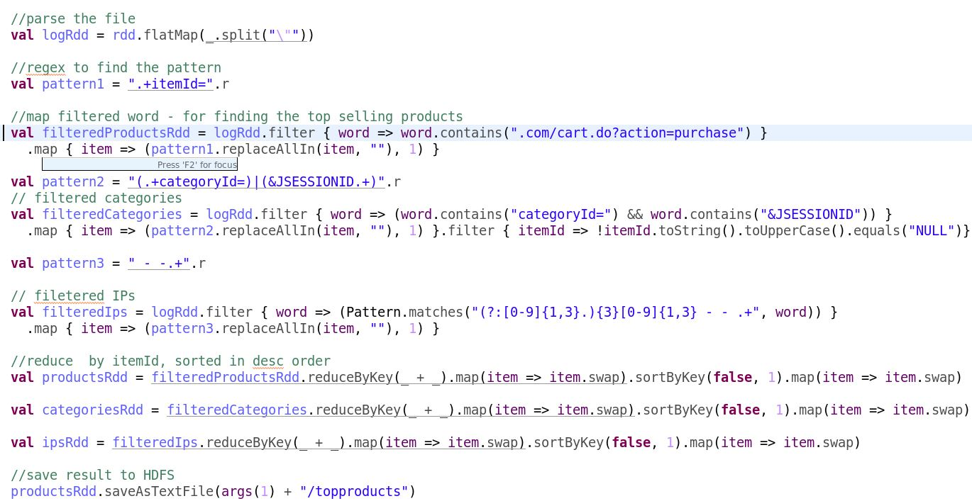
Log analysis - Scala implementation

Slide 39
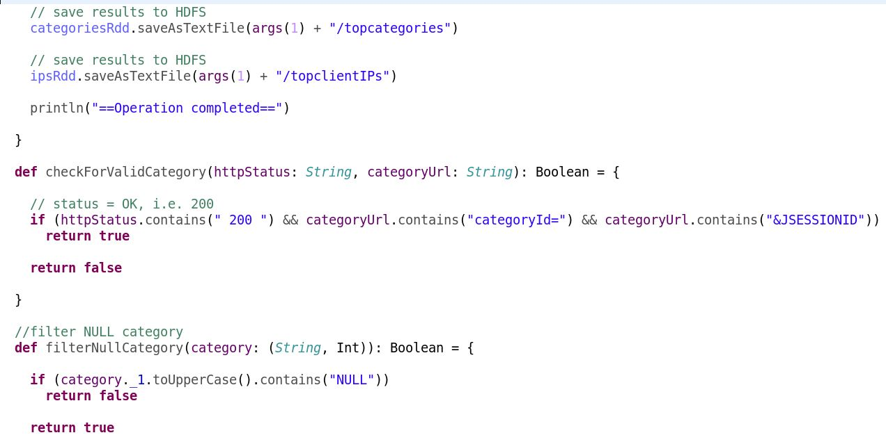
Log analysis - Scala implementation

Slide 40
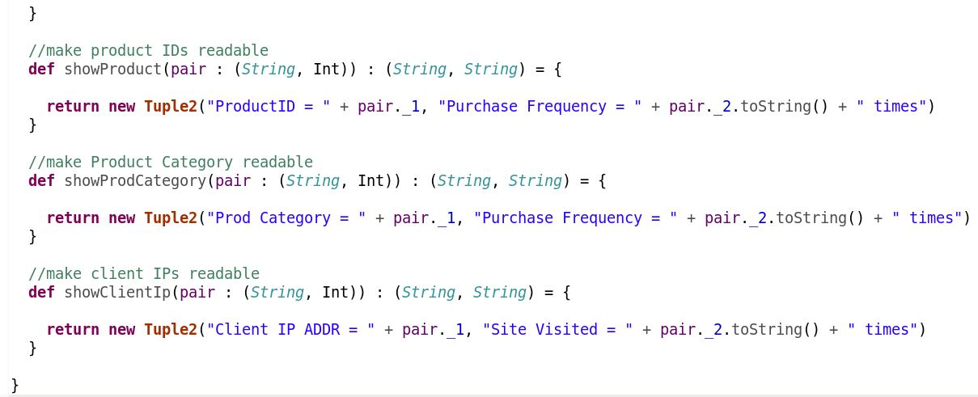
Log analysis - Scala implementation

Slide 41
Creating & executing the .jar file
Open Linux Terminal
Go to the project directory & Perform mvn clean, mvn package to create the .JAR file
Change the permission of .jar as executable ( sudo chmod 777 filename.jar )
Run the .jar file by providing the input and output directories as arguments
spark-submit --class cs522.sparkproject.LogAnalyzer $LOCAL_DIR/spark/sparkproject-0.0.1-SNAPSHOT.jar $HDFS_DIR/spark/input $HDFS_DIR/spark/output

Slide 42
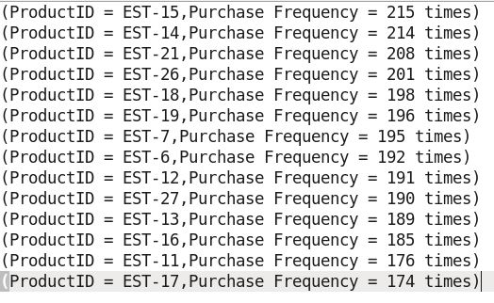
Log Analysis – Result (Top Product IDs)

Slide 43
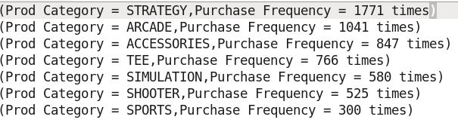
Log Analysis – Result (Top Product Categories)

Slide 44
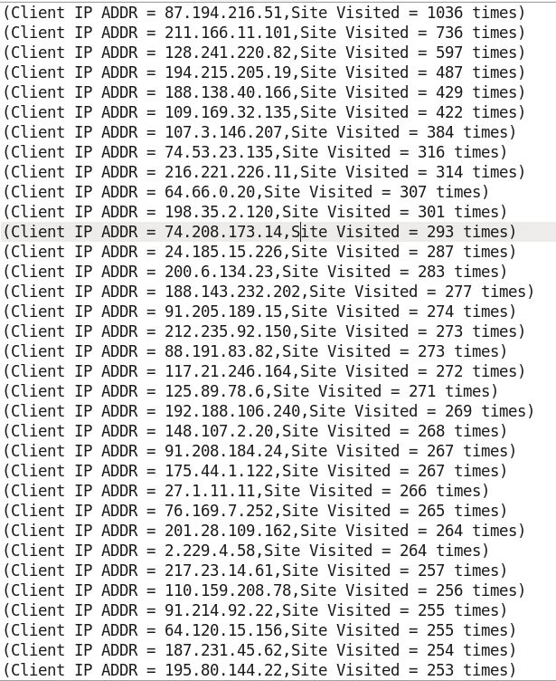
Log Analysis – Result (Top Client IPs)

Slide 45
DEMO

Slide 46

Questions & Answers Session

